Slide 1

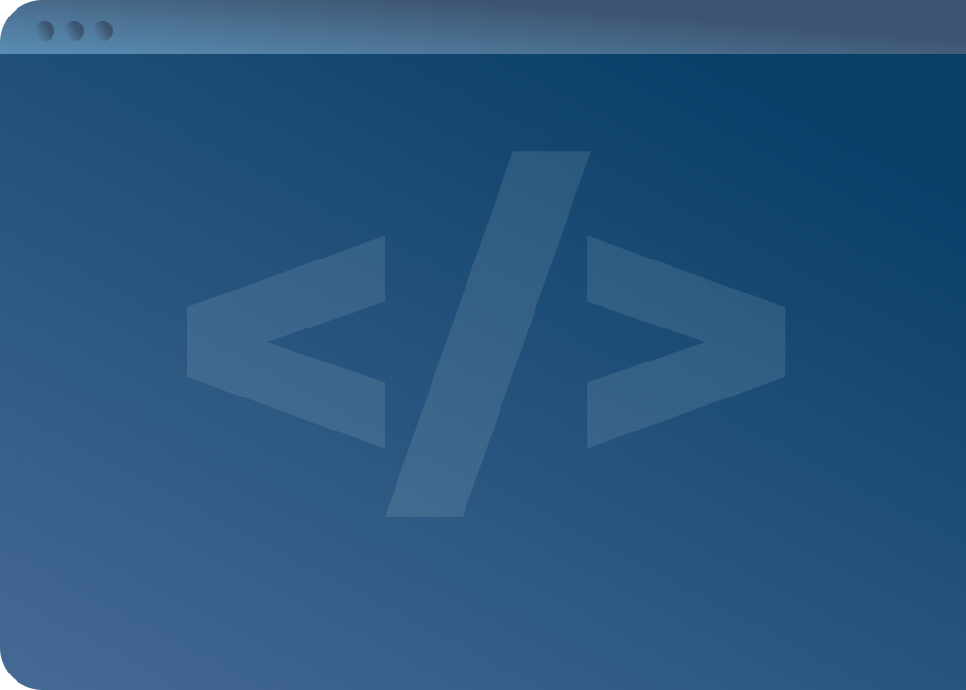

SOFTWARE DEVELOPMENT PROFESSIONAL PROGRAM
Intro to DOM Events

Slide 2





Intro to DOM Events
Learning Objectives
Attach an event listener to a DOM element.
Modify the DOM in response to a DOM event.
Use an event object to reference the target of a DOM event.

Slide 3
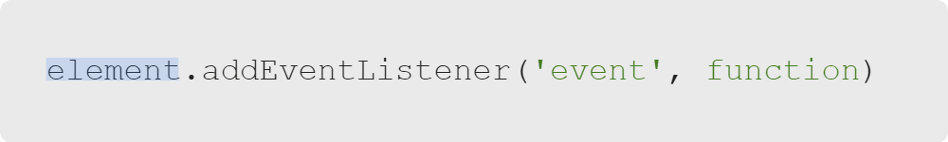
Intro to DOM Events
element.addEventListener
Can be called on any DOM element
Notes:
When using functions with ".addEventListener", the function (the code we write between the curly braces)
will only run when an event (like 'click') fires to run.
It is *listening* (waiting) for an event to trigger the function.
<<Insert an analogy here (for example "waiting for the previous runner to hand you a baton before you run")>>

Slide 4
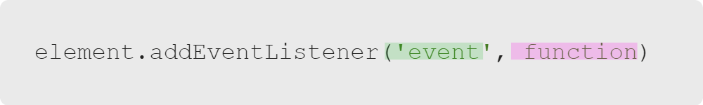
Intro to DOM Events
Event Listeners Are Functions
Event listeners are functions themselves.
Event listener functions take 2 arguments: an event and a function.
Notes:
Event listeners are functions themselves. When we call .addEventListener on an element,
the event listener will tell the browser to wait for the first argument, the event
(click, mouseover, etc.). Then the event listener will invoke the function that is
passed as the second parameter.

Slide 5
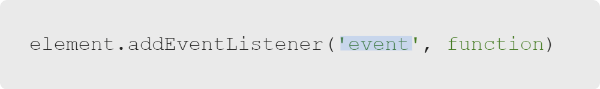
Intro to DOM Events
First Argument: An Event
Examples:
Click
Mouseover
Keypress
Drag
Notes:
What kinds of things do these events commonly trigger?
<<You can use an example or two to get learners started (for example "mousing over a product image will display its price")>>

Slide 6

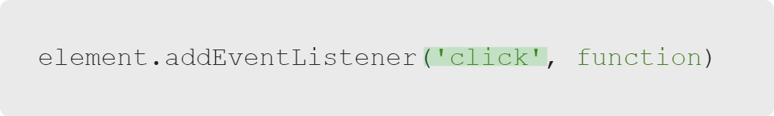

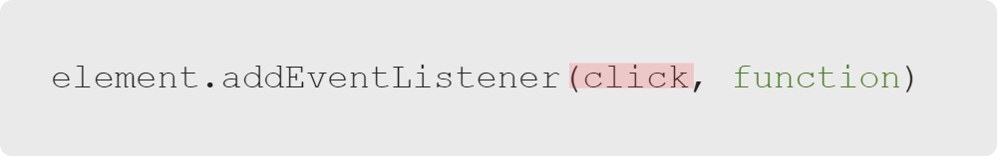
Intro to DOM Events
Warning: Always Pass Events as Strings

Slide 7
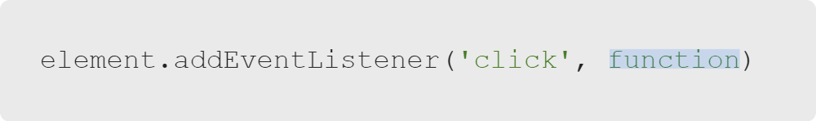
Intro to DOM Events
Second Argument: A Function
A function is code that runs when called.

Slide 8


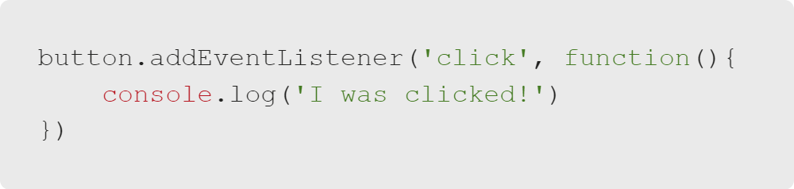
Intro to DOM Events
Example: addEventListener
Notes:
<<Exercise 01--console log a message when an element is clicked>>
<<Exercise 02--console log a message when an element is hovered over>>

Slide 9

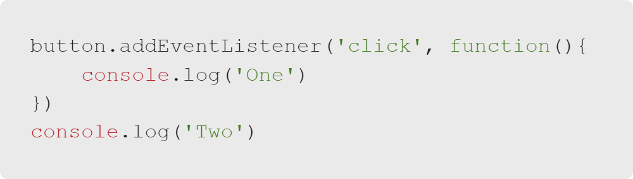
Intro to DOM Events
Question: Event Listeners
Which will be logged in the console first, one or two?

Slide 10
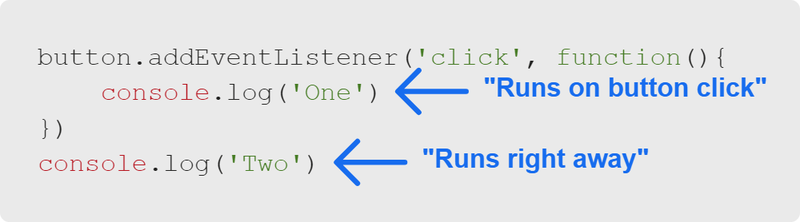
Intro to DOM Events
Answer
Two

Slide 11
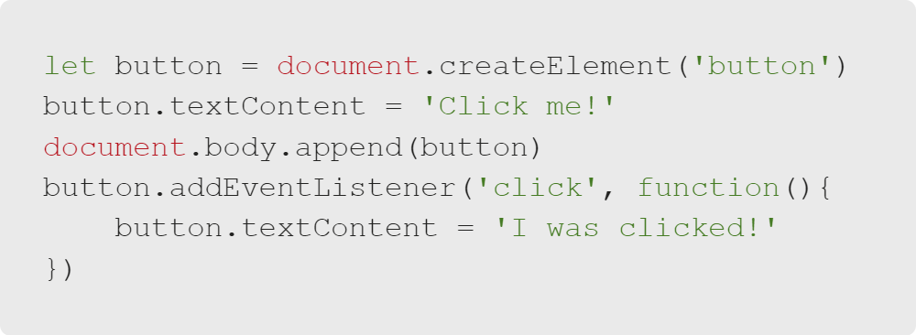
Intro to DOM Events
Dynamic Pages
Notes:
Using "addEventListener", we can make pages that respond to user interaction.
All we have to do is change the DOM (what the user sees) in an event listener, which runs when the user triggers an event.
We'll walk through this example together in eight steps.

Slide 12
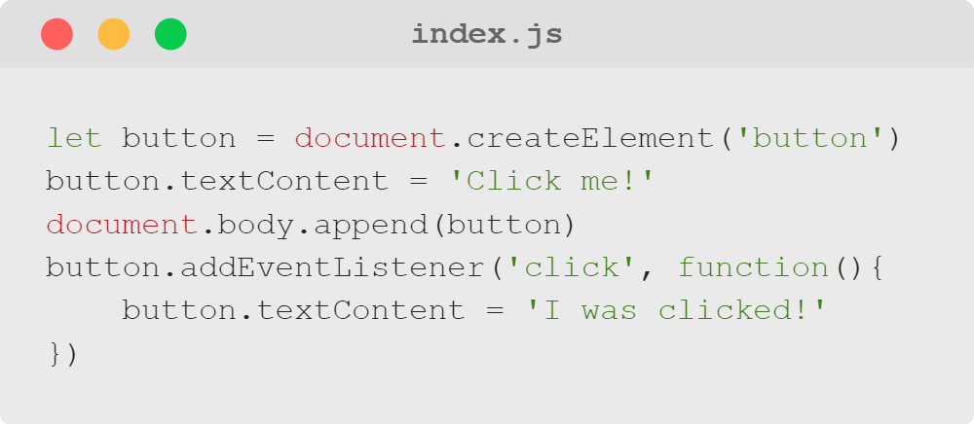
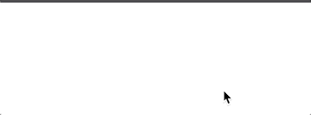
Intro to DOM Events
1. The Page Loads
Notes:
The blank screen is intentional here (nothing would show up yet at this point in the program)

Slide 13
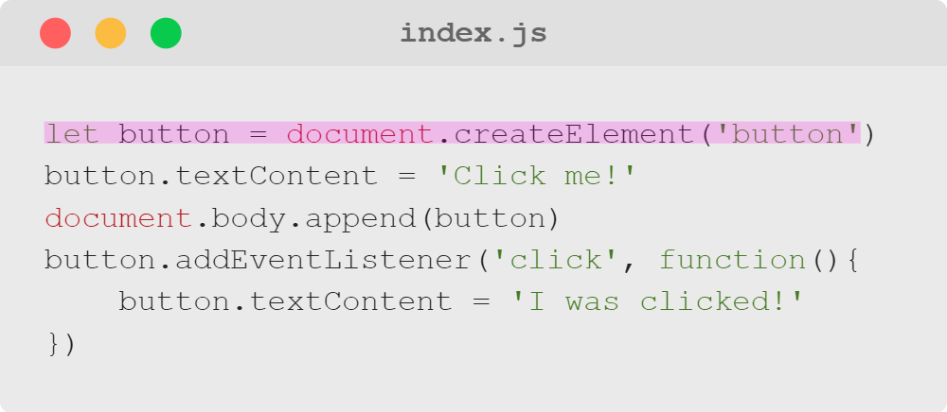
Intro to DOM Events
2. The Button Is Created
Notes:
The first line creates a button in JavaScript.
The page is still blank because we haven't put that element in the DOM yet.

Slide 14
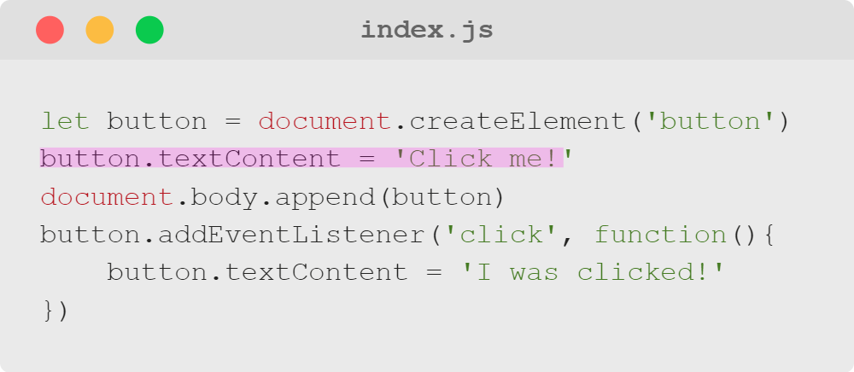
Intro to DOM Events
3. 'Click Me!' Is Added to the Button
Notes:
Next, we add some text to the button so users know what to do.
Again, because the element hasn't been appended anywhere to the DOM, our user still sees a blank page.

Slide 15
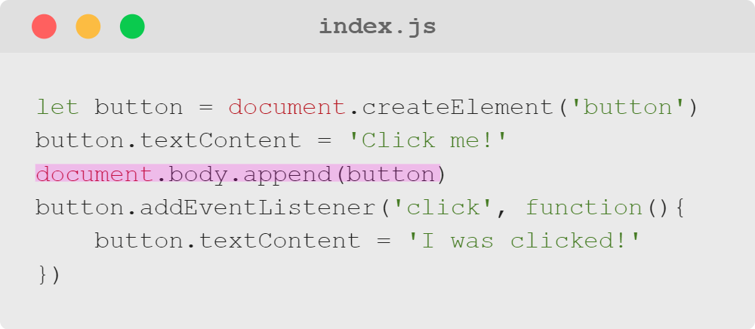
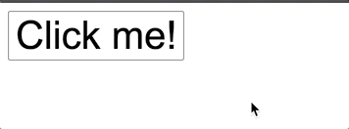
Intro to DOM Events
4. The Button Is Added to the Page
Notes:
This line appends our created button to the page, rendering it for the user.
It doesn't do anything yet when clicked.

Slide 16
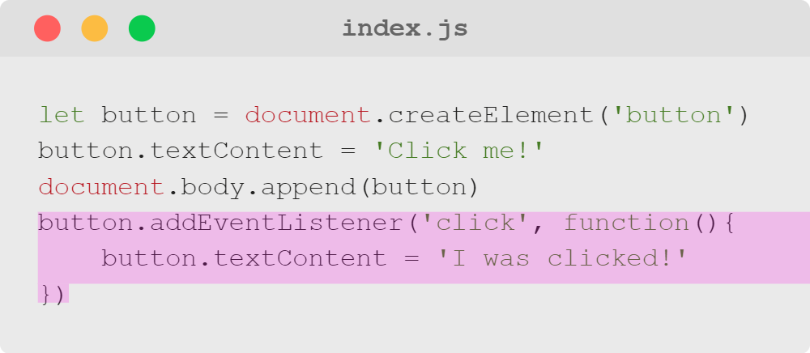
Intro to DOM Events
5. An Event Listener Is Added to the Button
Notes:
Now we can add an action when the user clicks! First, we add an event listener to our button element;
next we tell the event listener which event to listen for (in our case, a click);
then we define the function to be run using the keyword "function", parentheses, and curly brackets.
Finally, inside the curly brackets, we put the code that we want to execute when the button is clicked
(in our case, changing the text content of our button to read, "I was clicked!").
Remember, we are just establishing what happens when someone clicks a button--it hasn't happened yet!
The button will still have the same text we assigned to it a few lines earlier.

Slide 17
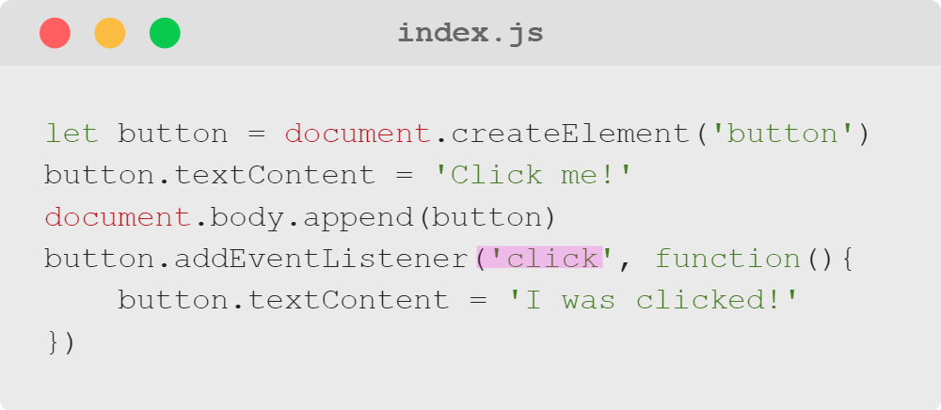
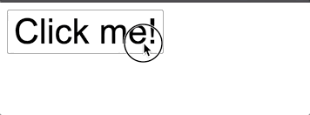
Intro to DOM Events
6. The User Clicks the Button
Notes:
This is a user interacting with our code. The only reason our code knows this is happening
is because we told it to listen for this type of interaction.

Slide 18
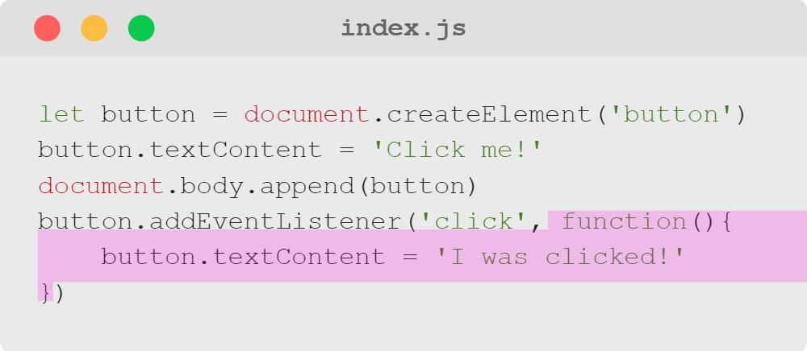
Intro to DOM Events
7. The Event Handler Starts to Run
Notes:
The user click is "heard" by the program which triggers the function to execute.

Slide 19
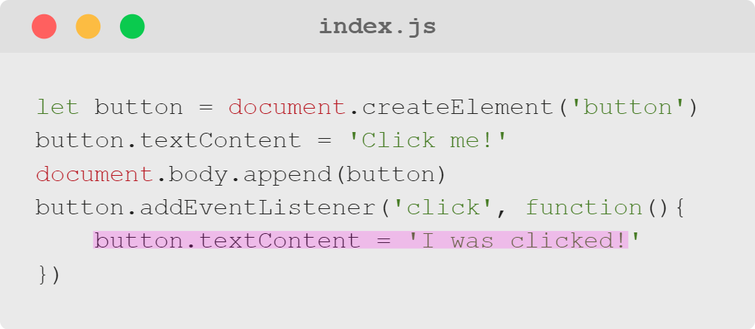
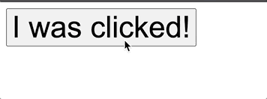
Intro to DOM Events
8. The Button's Content Changes
Notes:
The code we wrote in the curly brackets of the function runs, thus changing the text content of our button.

Slide 20

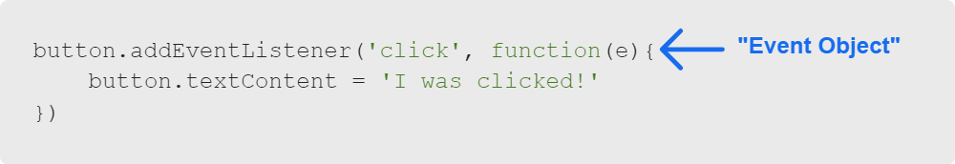
Intro to DOM Events
The Event Object
Notes:
We can access an object... What's an object?
We can access an object, which is a <<insert class's answer to prior question>> that represents the event that has fired.

Slide 21
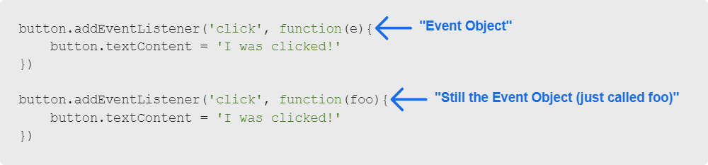
Intro to DOM Events
The Event Object
Notes:
We are *defining* a parameter here, not passing an argument. "addEventListener" passes in the argument when the event fires.
We are saying, "whatever value is passed in this funciton will be stored in a local variable called 'e'"
We could call this variable anything we want; conventionally, we call it 'e', though you may also see
'evt', 'event', or something similar.
<<The nuances of parameters may be beyond learners here; if there is a lot of confusion, simplify it down to
"write the function with an e in the parentheses and then you can access the event object in that function."
Learners will have more time to get comfortable with the topic in the extended course.>>

Slide 22
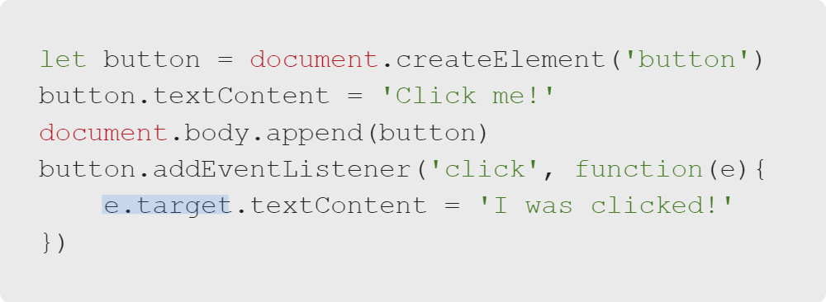
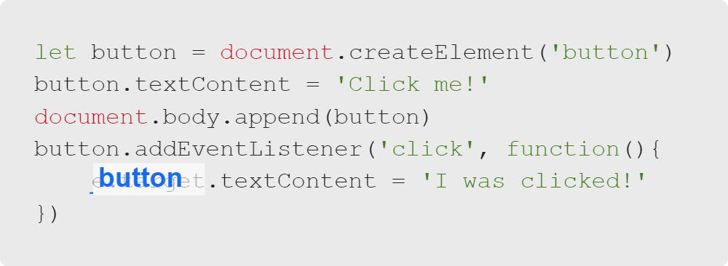
Intro to DOM Events
Event Target
The Event Object has many properties, but only a few of them are really relevant to what we're doing in this course.
Notes:
One property that we will use pretty regularly is the event target, which references the element that fired the event.
<<Exercise 03--change the text content of a button when clicked (use "e.target")>>
<<Exercise 04--change the background color of a header when hovered over (use "e.target")>>

Slide 23
Intro to DOM Events
Summary
What We've Covered:
Intro to DOM Events
Defining Event Listeners
Event Listener Arguments and Functions
Using .addEventListener
Event Target
Let's practice using event listeners to respond to user events.

Slide 24
Intro to DOM Events
How's it going?
Tell us about your experience in the Introduction to Software Development course.
Following the DOM Manipulation Quiz, please complete the final Experience Check-In Survey in Canvas.
Notes:
<< Direct learners to complete the Experience Check-In survey at the end of this module.
The survey must be completed to gain access material in the next module of the course. >>

